Slide 1
Are Data Struggles holding back your AI project? Are you ready for Open Metadata and the CDLA?
Jeff Borek
WW Program Director, IBM
Mandy Chessell CBE FREng CEng FBCS,
ODPi TSC Chairperson and ODPi Egeria project chairperson
Distinguished Engineer and Master Inventor, IBM

Slide 2
Data challenges are halting AI projects for multiple reasons, and open source developers are looking for solutions. Do you know how to share data sets properly? Just like software, you don't want to put your data sets out in the public domain without proper license protections. The Community Data License Agreement (CDLA) is a key part of the answer. About 80% of the work with an AI project is collecting and preparing data. Are you having challenges with 'data sprawl' across your company? How about GDPR compliance? An open metadata strategy can help. Open source project Egeria provides the open metadata and governance type system, frameworks, APIs, event payloads and interchange protocols to enable tools, engines and platforms to exchange metadata. Leading project community members bring experience from their roles at Cloudera, IBM, Index Analytics, ING, SAS, and others. Come join this session to learn how to get the best value from data whilst ensuring it is properly governed.

Slide 3
A hybrid multi-cloud world
Independent metadata Repository
New applications deployed to cloud
Mobile Apps
IoT devices and
systems
Business Partners
Sharing data
Linked metadata Repositories
Data Lake
Applications
Databases
Files
Applications

Slide 4

Creating the protected shell
Knowledge and action (to scale)
Metadata captures the knowledge
Metadata driven technologies provide the action
Automation is needed to keep costs down and to ensure action is complete and consistent
Business agility is critical
Flexibility to change actions
Enable the adoption of new technologies and techniques as appropriate.

Slide 5
Using a metadata repository to describe data
Metadata
Repository

Slide 6
Today’s reality – organizations buy lots of tools

Slide 7
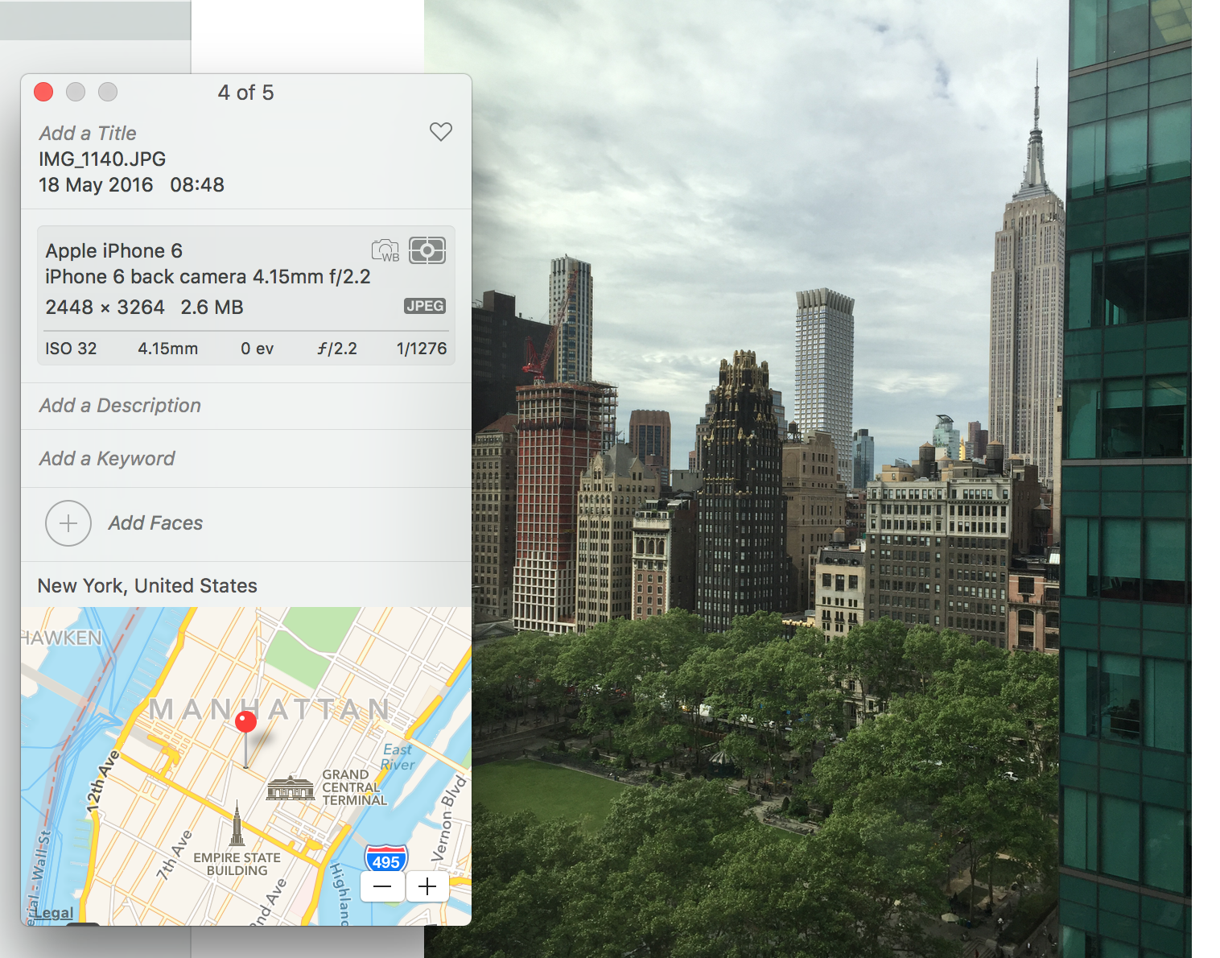
The value of open, standardized metadata
7
Notes:
AUTOMATED – Metadata is created by application at the same as the data is created in a standard manner easily consumable for all with necessary permissions
Device that took the picture / name of picture / settings picture was taken at / location geo tag of picture etc – all automatic – all done at creation of data time

Slide 8
ODPi Egeria enables the exchange of metadata between tools from different vendors
Development
DevOps
Data Science
Open and
Unified Metadata

Slide 9
Open metadata ecosystem
Independent metadata Repository
New applications deployed to cloud
Mobile Apps
IoT devices and
systems
Business Partners
Sharing data
Linked metadata Repositories
Data Lake
Applications
Databases
Files
Applications

Slide 10
Scale-out, scale down
OMAG Server Platform
OMAG Server Platform
OMAG Server Platform
OMAG Server Platform
Egeria Server 1
Egeria Server 2
OMAG Server Platform
Multi-tenant
Egeria Server 1
Egeria Server 3
Egeria Server 2
Egeria Server 3
Kubernetes
OMAG Server Platform
Egeria Server 1
Edge

Slide 11


Automating governance example
Define Policies
Hadoop Metadata
Open
Governance APIs
Access
Data
IBM
Information
Governance
Catalog
Apache Atlas
Egeria
configure
Gaian
configure
Apache Ranger
Manage Data Access
Egeria Cohort
(Open metadata exchange and federated queries)

Slide 12
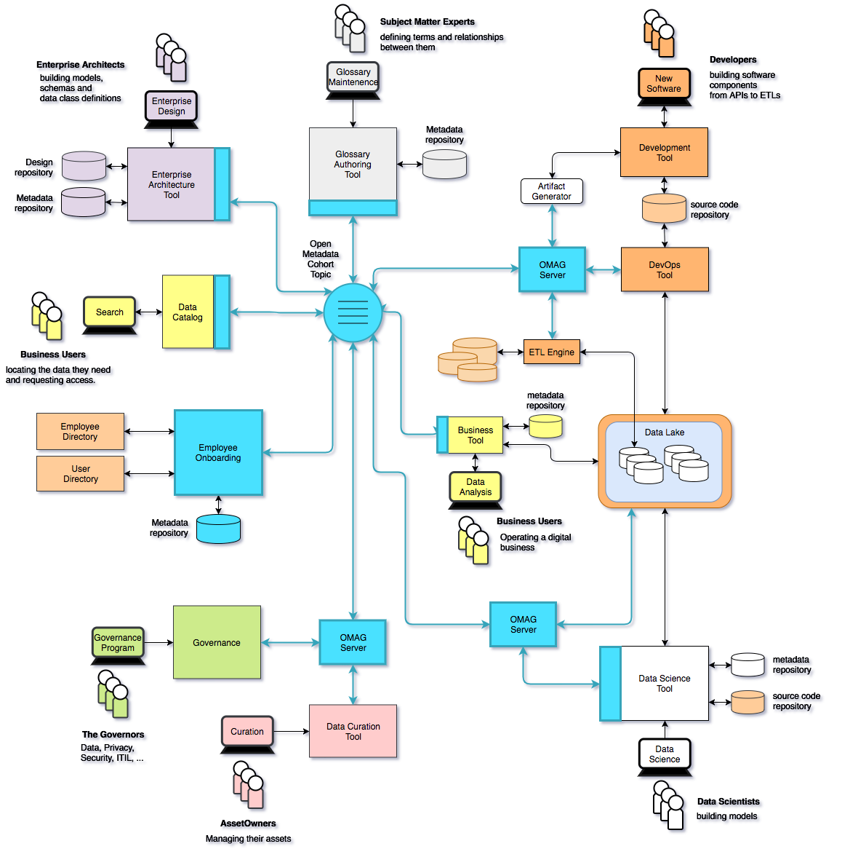
Using ODPi Egeria …
Eases the cost of metadata integration through
Comprehensive standards and libraries.
Active vendor recruitment program.
Provides direct support to many governance roles, filling the gaps between function offered through commercial tools.
Provides best practices and content packs to accelerate an organization’s journey to becoming data driven.

Slide 13
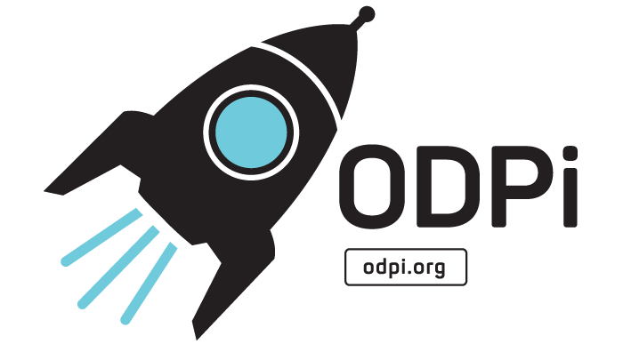



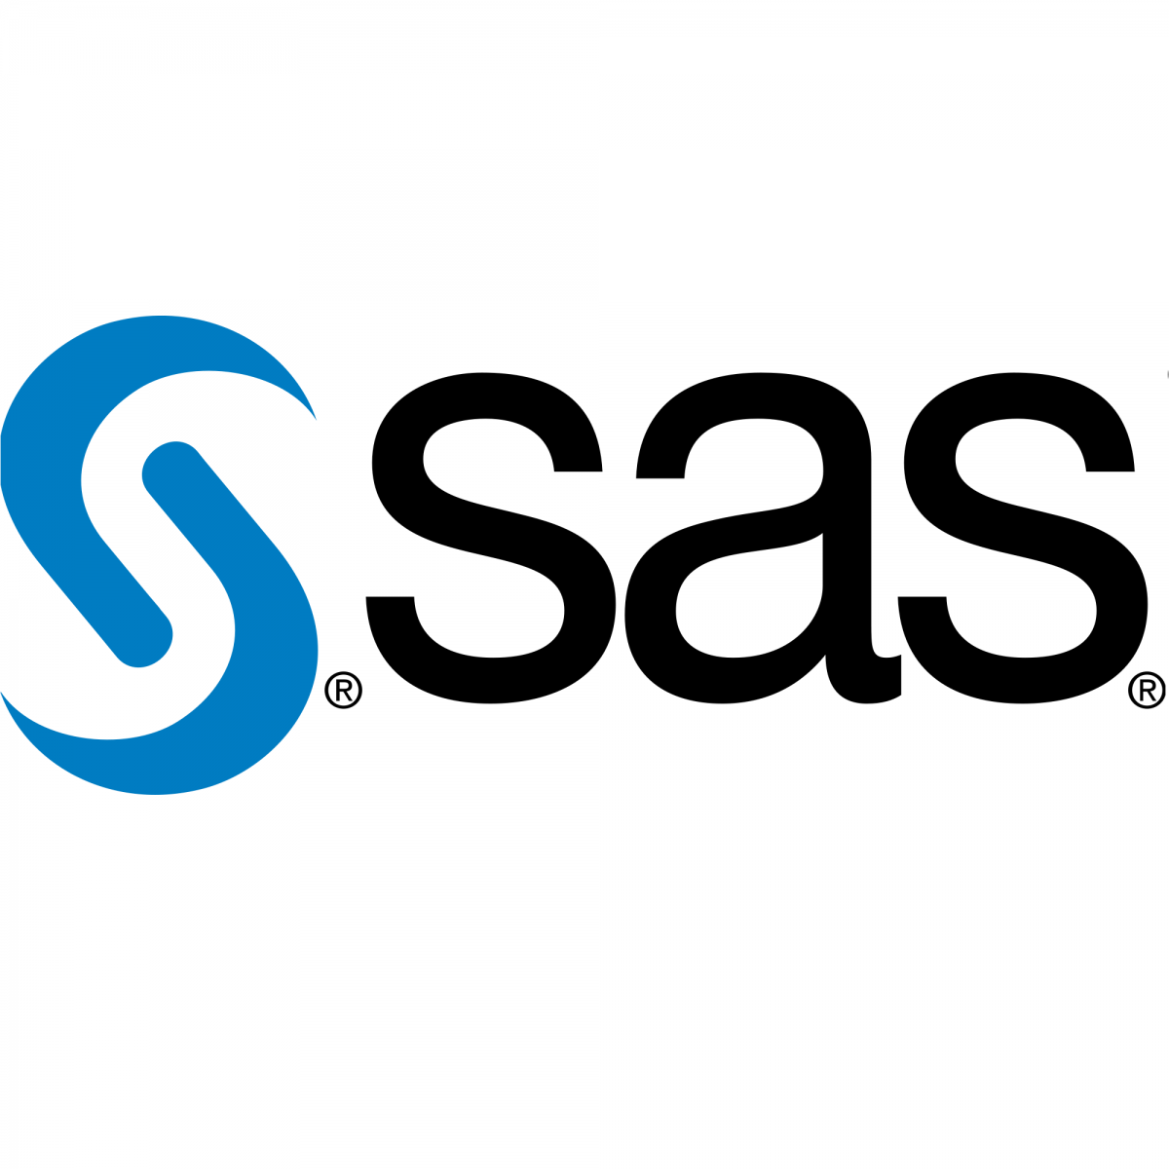

The ODPi foundation is part of The Linux Foundation
Delivering core technology
Recruiting vendors
Assisting practitioners
Core Technology
Vendors
Project
Egeria
Conformance Suite
Practitioners
Best Practices
Project
Data
Governance

Slide 14





Taking the next step with ODPi Egeria
Kubernetes/Docker deployment
Hands on labs
Coding samples
Guidance on governance
Governance Teams
Policy
Policy
Audit
Define
Asset Owners
Enterprise Architecture
Monitor
Policy
Roll out
Classify
Operations
Policy
Metadata
Development
Stewards
Design
Execute
Business Users
Deploy
Developers
Detect
Remediate
Develop
Data Scientists
DevOps

Slide 15
What do you need to do next?
How do you begin to take advantage of this?
Map landscape
Support current business and preparing to take advantage of Egeria
Identify metadata council member of org …

Slide 16
A hybrid multi-cloud world
Independent metadata Repository
New applications deployed to cloud
Mobile Apps
IoT devices and
systems
Business Partners
Sharing data
Linked metadata Repositories
Data Lake
Applications
Databases
Files
Applications

Slide 17
Community Data License Agreement (CDLA)
The CDLA-Sharing license ensures that downstream recipients can use and modify that data, and are also required to share their changes to the data.
The CDLA-Permissive agreement allows anyone to use, modify and do what they want with the data with no obligations to share any of their changes or modifications.
The Inbound License
governing the contribution of data to the data set
The Outbound License or Technical Restrictions on Use
governing the use and distribution of the data set
Charter of the Community that Is Entrusted with the Data
governing the custodians of the data set

Slide 18
Open forum
z
z
z
z
z
z
z
Questions?

